Slide 1
INFLUENCE OF WEIGHT DUE TO THE OTHER ELEMENTS ON SIMPLE ENGINE KINETICS
In the earlier analyses though the weight of the element (i.e. piston), externally applied force (gas force) and dynamic force (inertia force) have been considered, the weight due to the other element/s and the consequent influence has not been considered. Here we would take the mass (thus weight) and moment of inertia of the connecting rod (which is really significant in big engines) into consideration and observe to which extent that influence/modify the kinetic analysis.
Prerequisite:
What are static equivalence and dynamic equivalence?
Explanation of the same in relation to connecting rod.

Slide 2
STATIC AND DYNAMIC EQUIVALANCES
The attributes of the body which determine its dynamical properties are its mass, the position of its centre of gravity and its moment of inertia. If the mass of the body under consideration is replaced by two point masses (lumped) the replacement would be dynamically equivalent if, and only if, it identically reflects the above three properties of the body.
If the connecting rod of mass M is replaced by two lumped masses m₁ and m₂ , then for dynamic equivalence:
Total mass unaltered, m₁ + m₂ = M
Position of C.G. unaltered, m₁a₁ = m₂a₂ ; a₁ and a₂ are the distances of m₁ and m₂ from the C.G. respectively
Moment of inertia unaltered, m₁a₁² + m₂a₂² = I = Mk² where k is the radius of gyration
Here the first two conditions are for static equivalence, and third one in addition is for dynamic equivalence.

Slide 3
(CONTINUED)
The mentioned three conditions can be summarized as: a₁a₂ = k².
The problem is, for the dynamic equivalence, there are four unknown quantities to be found out, namely, m₁, m₂, a₁ and a₂ where as there are only three conditions to satisfy. It follows that we can make an arbitrary (within reason) convenient choice of any one of these four, and the remaining three will then be determinate.

Slide 4
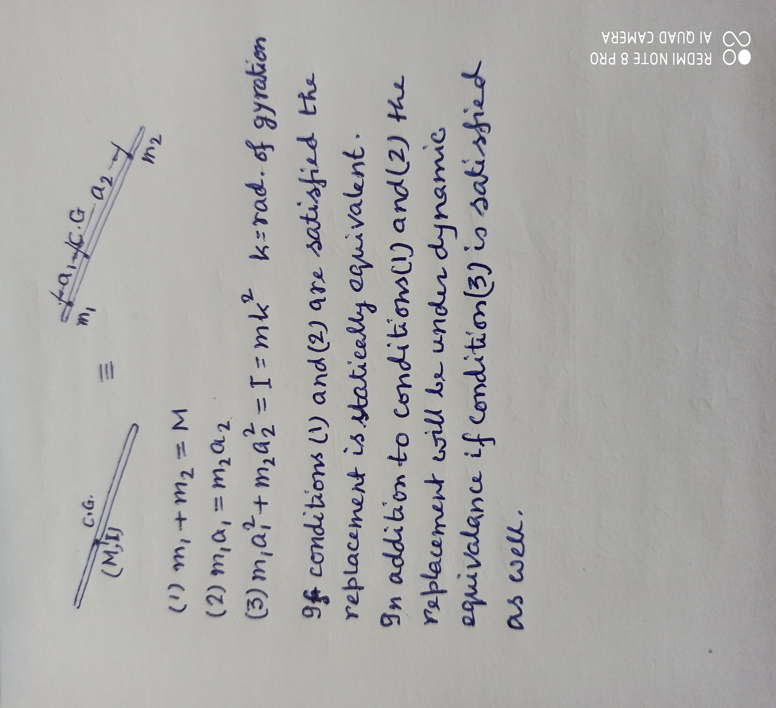
SCHEMATIC FOR DYNAMIC EQUIVALANCE

